Slide 1
Implementation of 3D Obstacle Compliant Mobility Models in ns-3
Paulo Alexandre Regis, Suman Bhunia, Shamik Sengupta

Slide 2
Outline
Introduction
Motivation
Related Work
Mobility Models
ns-3 Classes
Results
Conclusion and Future Work

Slide 3
Outline
Introduction
Motivation
Related Work
Mobility Models
ns-3 Classes
Results
Conclusion and Future Work

Slide 4
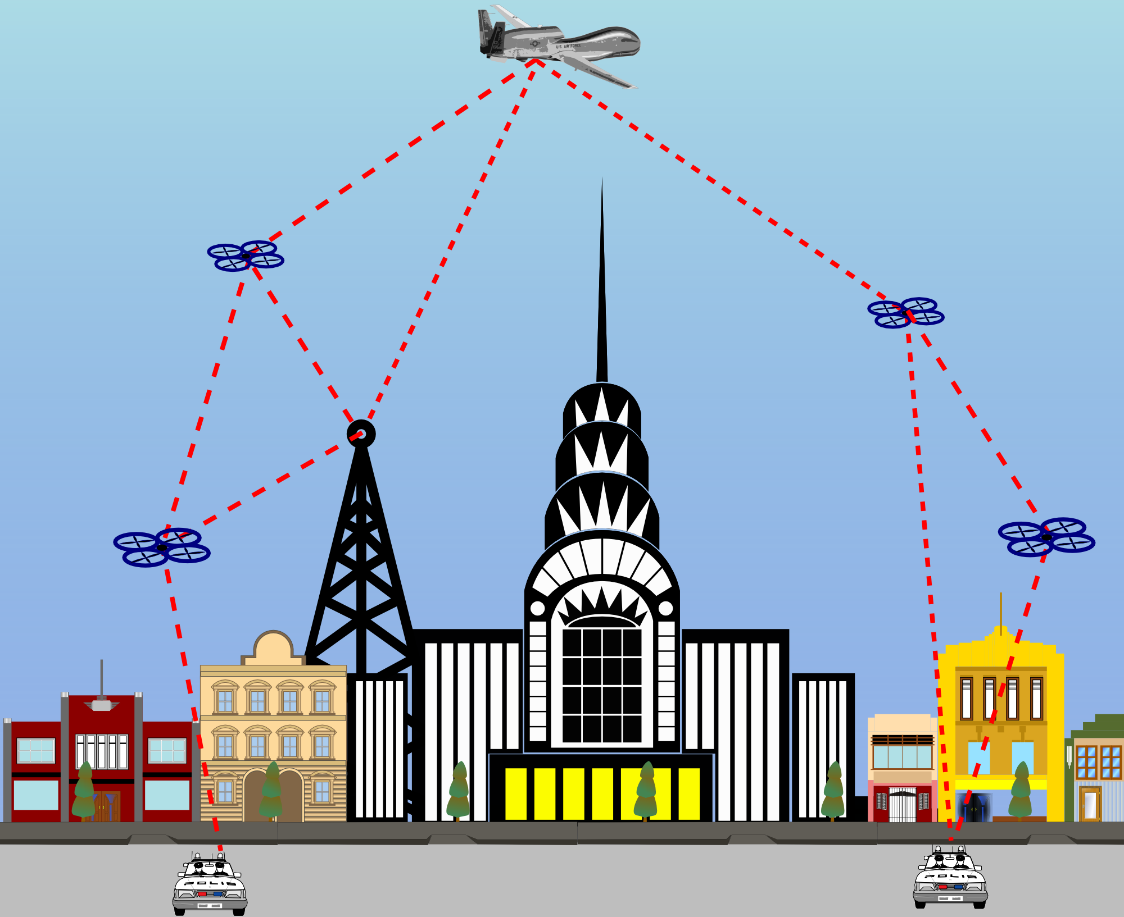
Unmanned Aerial Vehicles (UAV) network
Ad hoc: Collection of nodes communicating with each other independent of a central infrastructure.
Multihop: Data traverses through multiple nodes
Applications include emergency radio networks in disaster zones, traffic monitoring, and military (ISTAR) missions

Slide 5
Mobility model
Defines how the movements of a node will change over time
Most models assume movements in a 2D plane
Different models account for different characteristics: randomness, dependence on previous movement, movement restrictions
Examples: Random Walk, Random Direction, Gauss-Markov, Paparazzi

Slide 6
Outline
Introduction
Motivation
Related Work
Mobility Models
ns-3 Classes
Results
Conclusion and Future Work

Slide 7
Urban environment challenge
Nevada’s drone test site
UAVs agility allows it quickly change direction
Fast prototyping heterogeneous ad hoc networks
Initially developed for another work in preventing jamming attacks

Slide 8
Objectives
Mobility models that allow agile movements in three dimensions
Extend existing models: random walk, and random direction, Gauss-Markov
Add the ability to avoid collision with the obstacles in 3D
Allow simulations with multiple obstacles
Nodes reflect/bounce similarly when they reach the boundaries
Investigate the effect objects can cause in ad hoc networks

Slide 9
Outline
Introduction
Motivation
Related Work
Mobility Models
ns-3 Classes
Results
Conclusion and Future Work

Slide 10
Existing models
Random Walk (2D)
Nodes move in a straight line for a determined amount of time
Randomly choose new parameters
Random Direction (2D)
A node moves in straight line until it reaches the boundary
Randomly chooses new parameters
Gauss-Markov (3D)
Similarly to Random Walk, moves for a certain time before changing parameters
Parameters can be constrained by random distributed variables
Same as Random Walk depending on the initial setup

Slide 11
Outline
Introduction
Motivation
Related Work
Mobility Models
ns-3 Classes
Results
Conclusion and Future Work

Slide 12
Scope of work
New classes added to the mobility module
Modification of existing auxiliary classes
No functions were removed/modified
Only new methods added to account for 3D geometry

Slide 13
General block diagram
All models follow similar flow
Intermediate yellow blocks represent the new features
Coordinate system used in ns-3

Slide 14
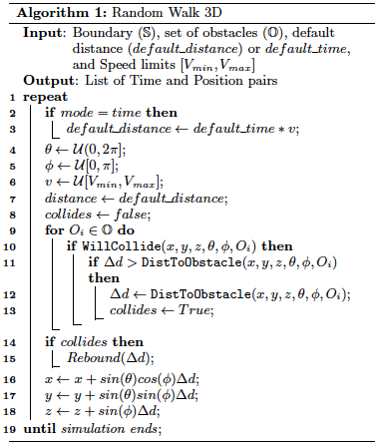
Random Walk 3D
New random variable controls vertical movements
Initialize the obstacles
During the simulation
If collision is detected, change direction similarly as if it reached the boundary
Continue moving for the remaining time step

Slide 15
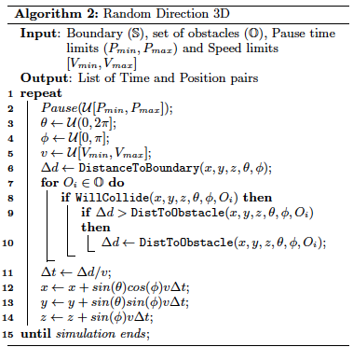
Random Direction 3D
New random variable controls vertical movements
Initialize the obstacles
During the simulation
Move until boundary OR object collision is detected
Choose new direction (avoiding same direction as the obstacle/boundary)

Slide 16
Obstacle Gauss-Markov
Similar to Random Walk algorithm
Already 3D, no modifications needed
Initialize the obstacles
During the simulation
If collision is detected, change direction similarly as if it reached the boundary
Continue moving for the remaining time step

Slide 17
Outline
Introduction
Motivation
Related Work
Mobility Models
ns-3 Classes
Results
Conclusion and Future Work

Slide 18
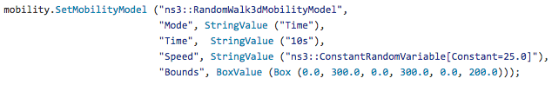

ns3::RandomWalk3dMobilityModel
Create model with the helper class
Add as many obstacles as needed

Slide 19
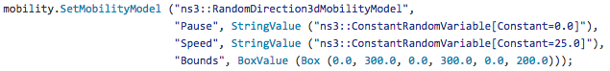

ns3::RandomDirection3dMobilityModel
Create model with the helper class
Add as many obstacles as needed

Slide 20
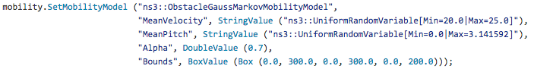

ns3::ObstacleGaussMarkovMobilityModel
Create model with the helper class
Add as many obstacles as needed

Slide 21
ns3::Box
Geometric calculation includes Z-axis calculations (not included originally)
Slab method used in gaming, i.e. projectile intersection
Box::CalculateIntersection
Input: current position and velocity vectors
Output: intersection position vector
Box::WillCollide
Input: current position and velocity vectors
Output: boolean, if node is in collision trajectory or not

Slide 22
Outline
Introduction
Motivation
Related Work
Mobility Models
ns-3 Classes
Results
Conclusion and Future Work

Slide 23
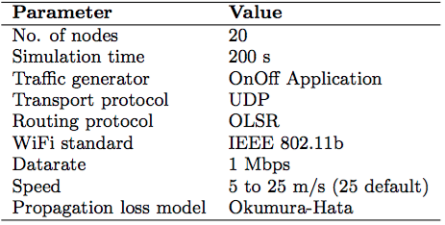
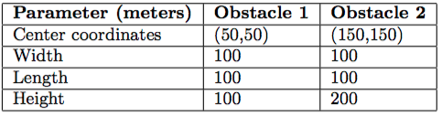
Simulation Parameters
Boundaries: 300 x 300 x 200 (m)
Obstacles

Slide 24
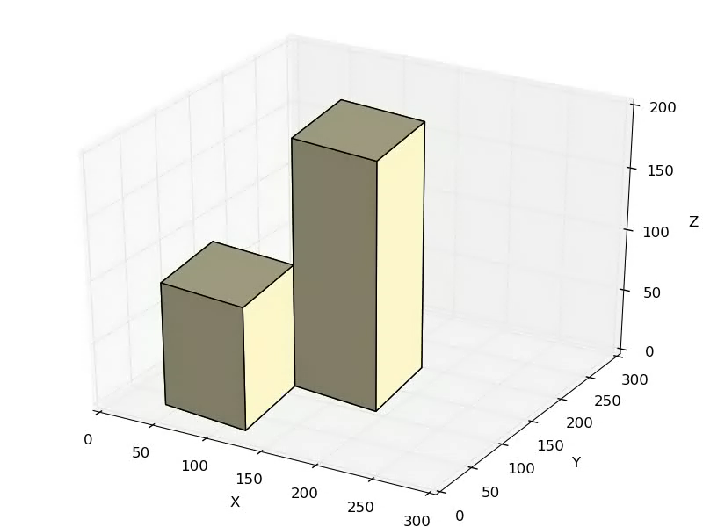
Trajectory comparison
Random Walk 3D (time)
Random Walk 3D (distance)
Random Direction 3D
Obstacle Gauss-Markov
Notes:
One hop communication links are repre-
sented with yellow lines. The cyan and magenta lines represent
the null borders b l and b h respectively.

Slide 25
Number of collisions with the obstacles
No obstacle
With obstacles

Slide 26
Control Packet Delivery Ratio
No obstacle
With obstacles

Slide 27
Hop count
No obstacle
With obstacles

Slide 28
Outline
Introduction
Motivation
Related Work
Mobility Models
ns-3 Classes
Results
Conclusion and Future Work

Slide 29
Conclusion and Future Work
Expanded three mobility models to consider 3 dimensions, and obstacles in simulations with moving nodes
Allows fast prototyping, eliminating the need to learn an external tool to obtain trajectory in such cases
Results demonstrate the deteriorating effect each mobility has when obstacles are considered
Future work:
More complex mobility models
Integrate with buildings module

Slide 30
External links
Project website:
http://www.cse.unr.edu/~regis/ns-3/
Source-code on GitHub:
https://github.com/regisin/ns-3-obstacles

Slide 31
Acknowledgement
This research was supported by the National Science Foundation, Partnership for Innovation Program, Grant No. 1430328 and CAPES Brazil 13184-13-0.

Slide 32
Thank You!

